Slide 1
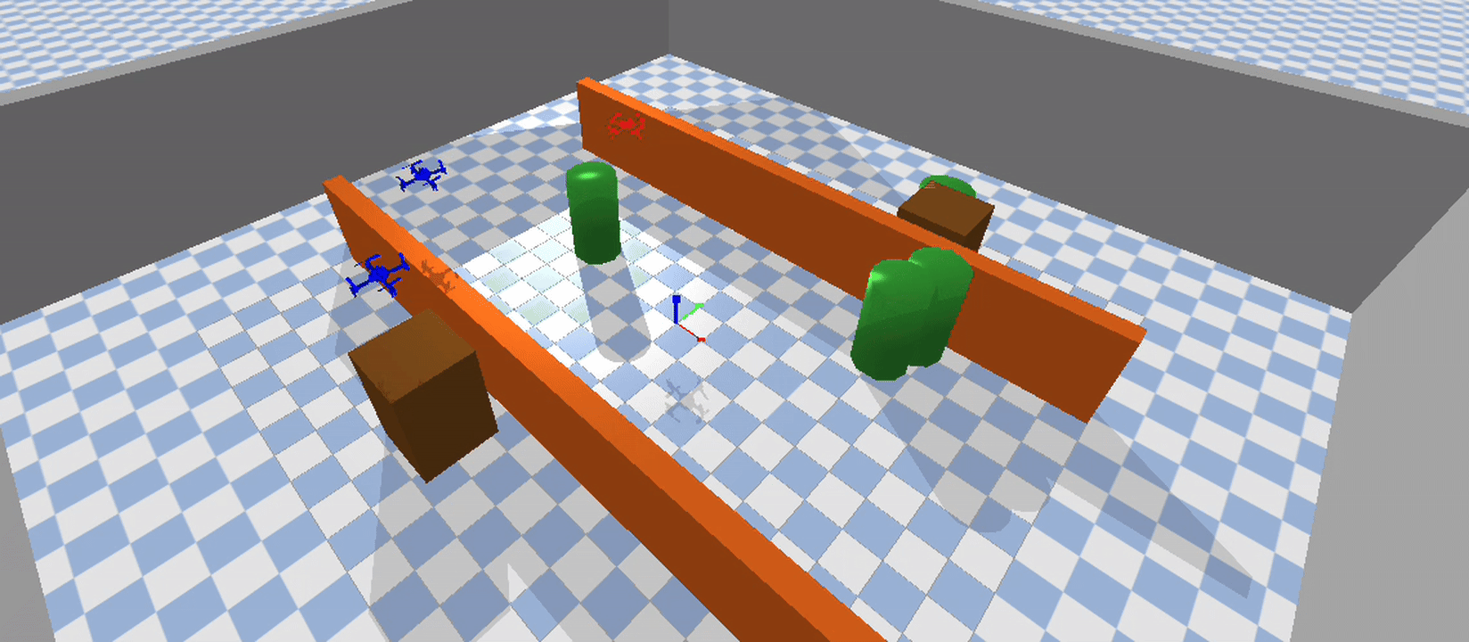
Multi-UAV Pursuit Evasion using MAPPO and PyBullet
- Vaseem Ahmed (lnc102)
CS.5325 Reinforcement Learning

Slide 2
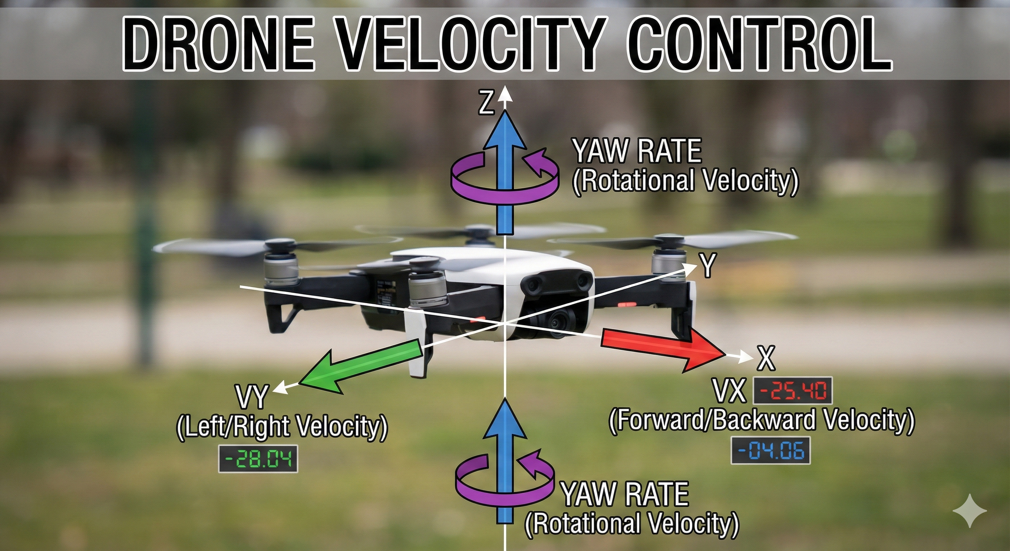
INTRODUCTION
Dimension | Description
3 | Self position (x, y, z) in world coordinates
3 | Self velocity (vx, vy, vz)
3 | Relative evader position (evader - self)
1 | Distance to evader (Euclidean norm)
6 | Other pursuers' relative positions (2 teammates × 3D)
9 | 3 nearest obstacles' relative positions (3 obstacles × 3D)
3 | Evader velocity (vx, vy, vz)

Slide 3
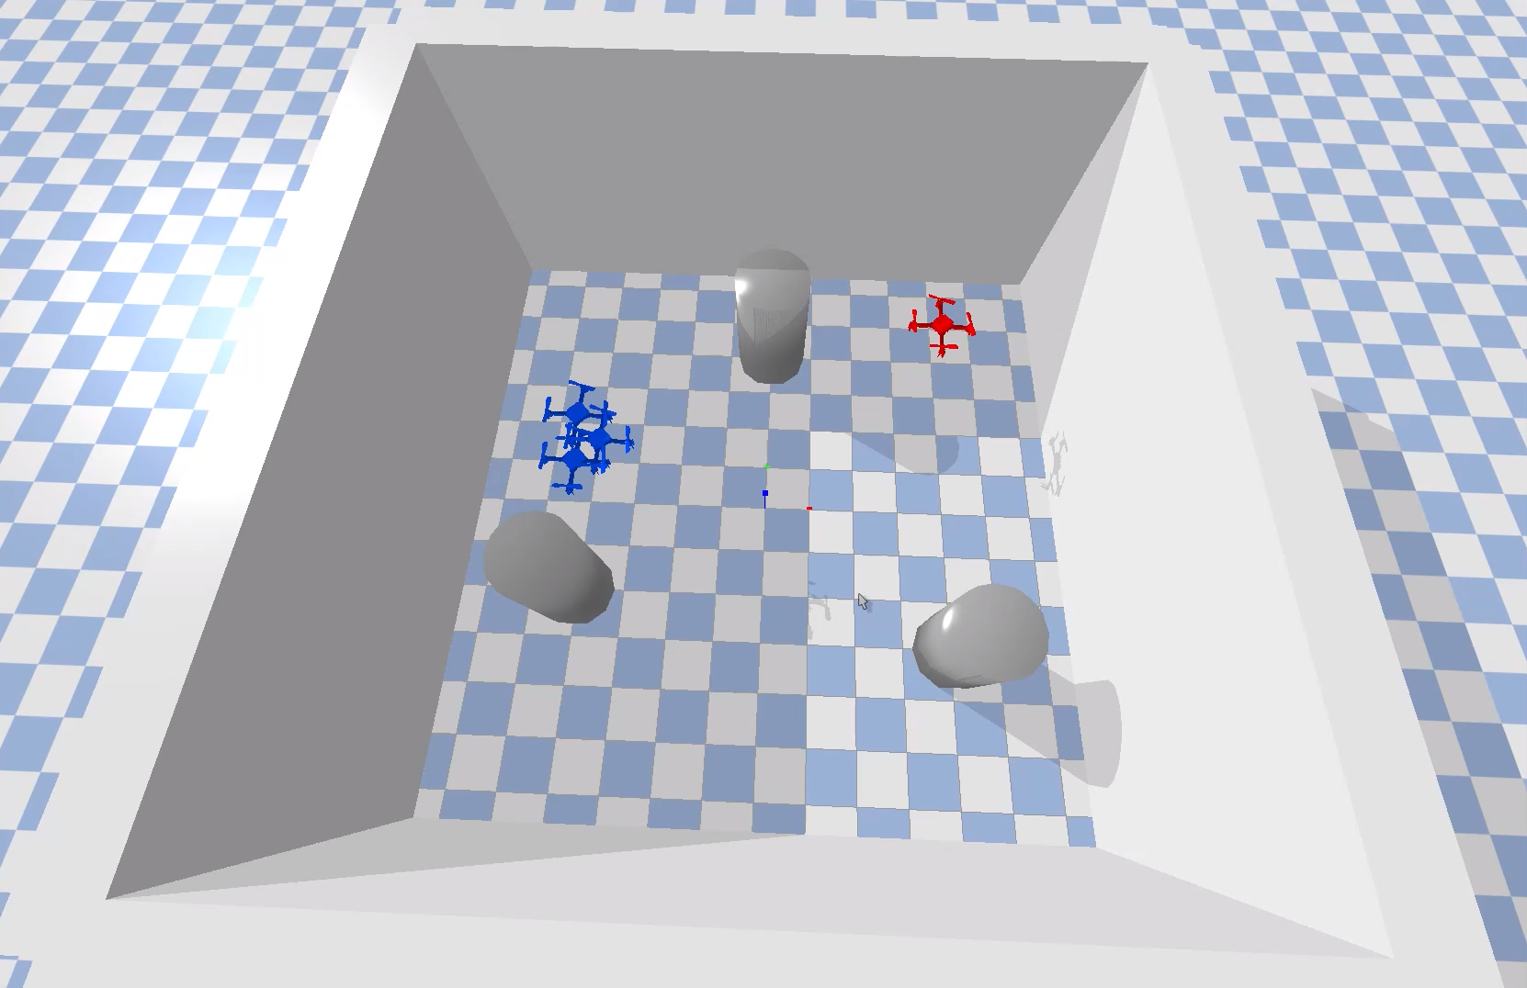
Cont.

Slide 4
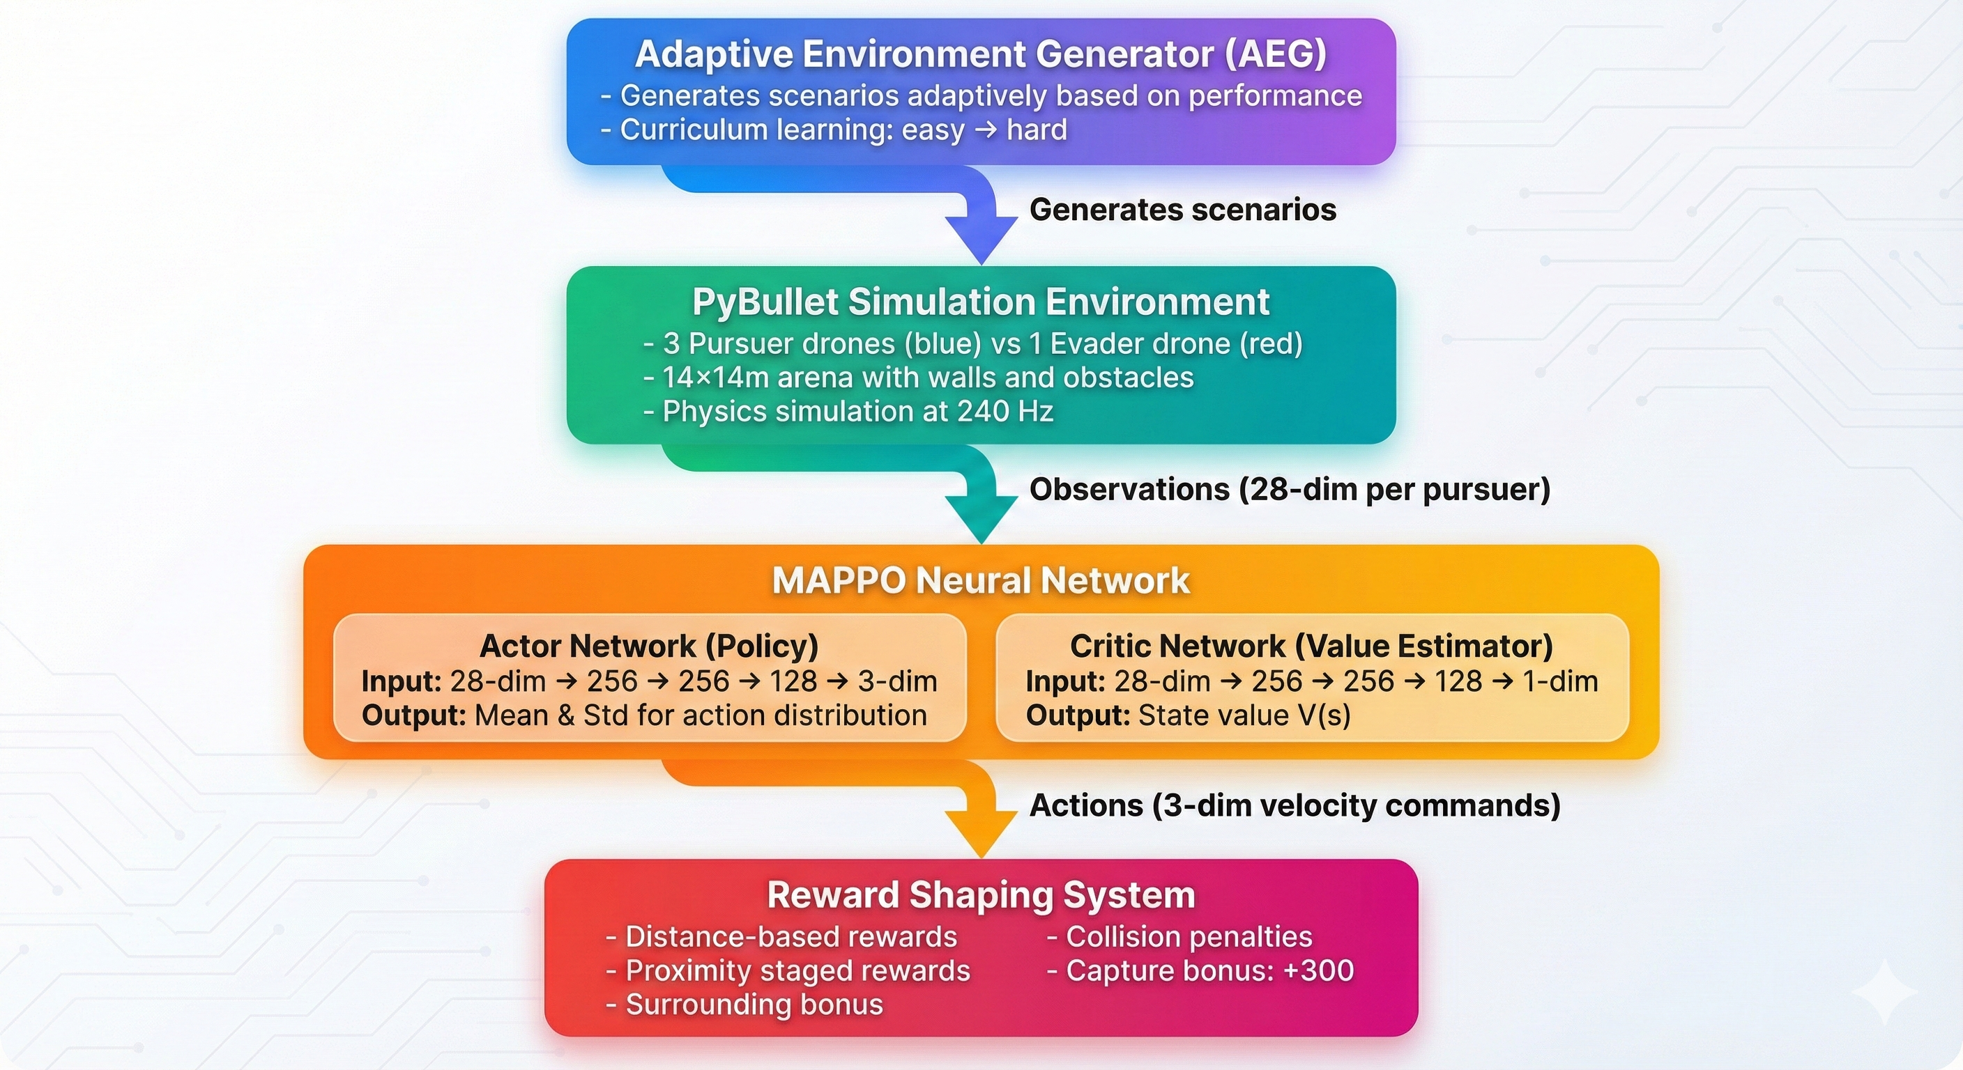
METHODOLOGY

Slide 5
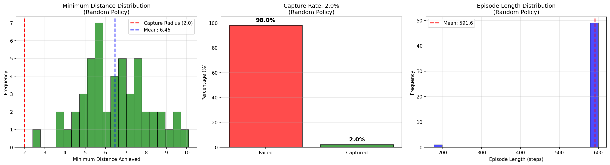
TRAINING

Slide 6
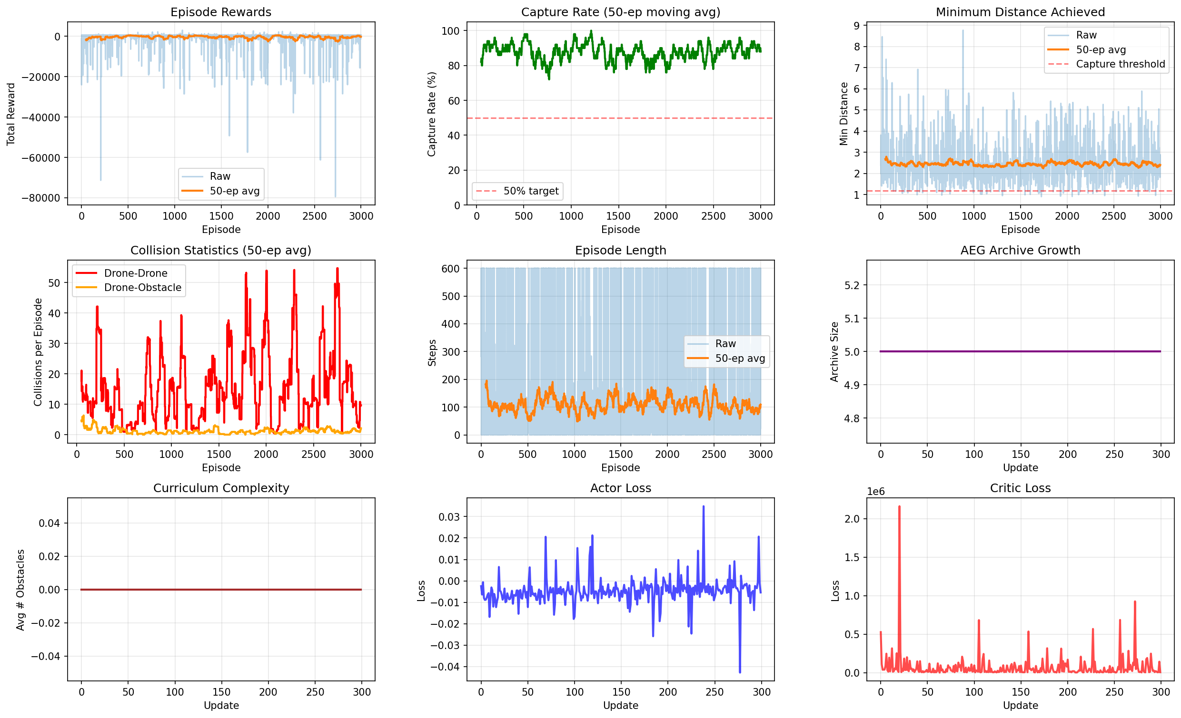
Cont.

Slide 7
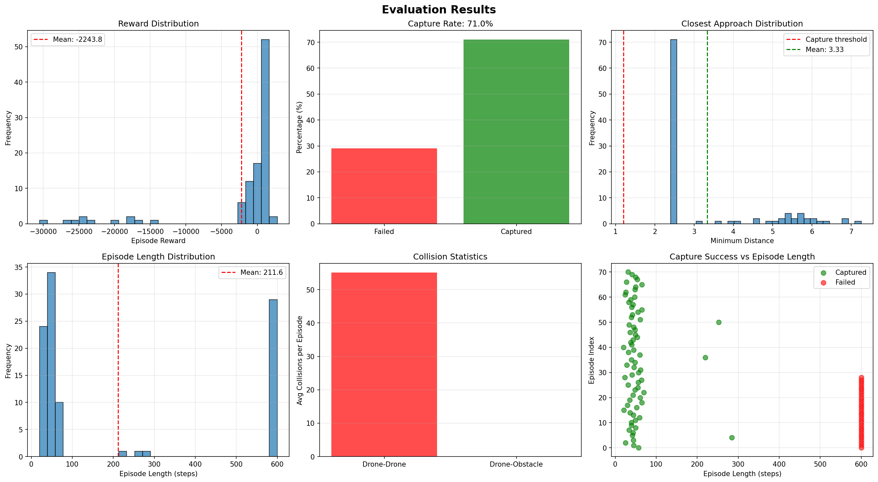
RESULTS

Slide 8
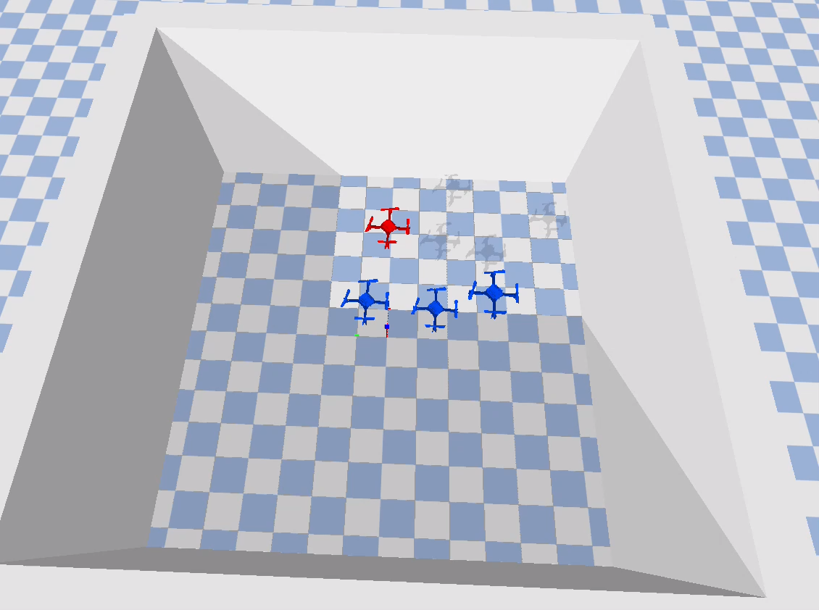
PY-BULLET SIMULATION
Easy: close start with no obstacles
Episodes: 3
Capture Rate: 100.0%
Avg Steps: 51.7
Avg Reward: 364.9
Avg Min Distance: 2.46
Avg Min Distance: 2.48

Slide 9
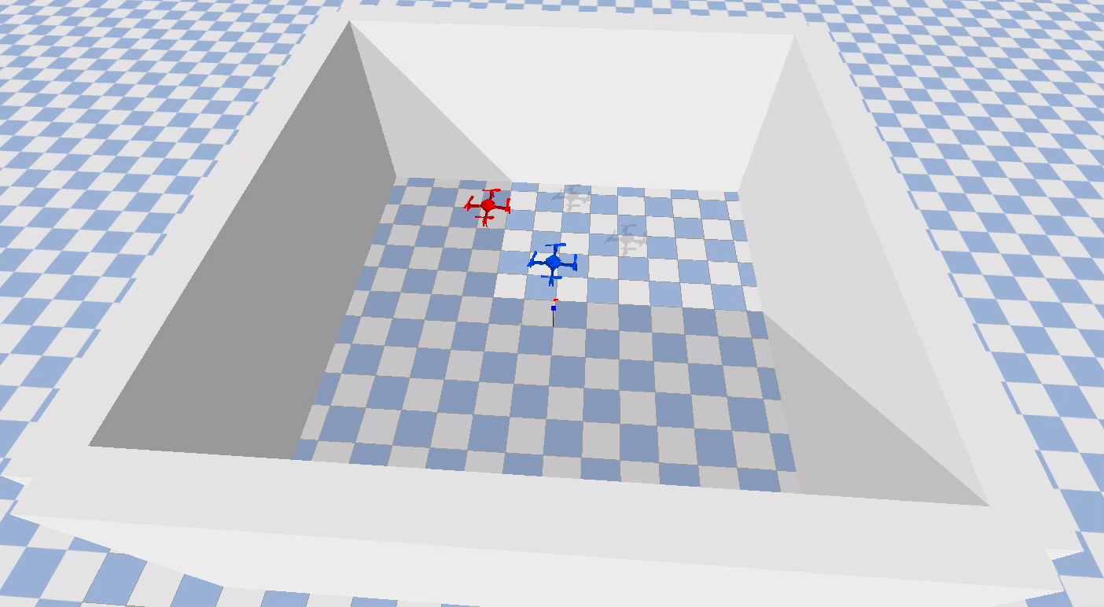
Cont.
Medium: little far start, with obstacles
Evader Speed: 2.000
Steps: 68/600
Total Reward: 198.2
Min Distance Achieved: 2.45
Capture Radius: 2.50

Slide 10
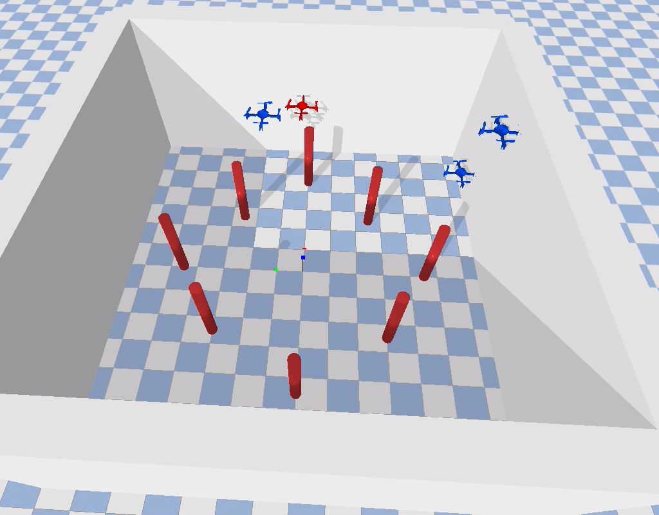
Cont.
Hard: very far with many obstacles
Evader Speed: 2.000
Steps: 102/600
Total Reward: -58.2
Min Distance Achieved: 2.48
Capture Radius: 2.50
Drone-Drone Collisions: 0
Drone-Obstacle Collisions: 0

Slide 11
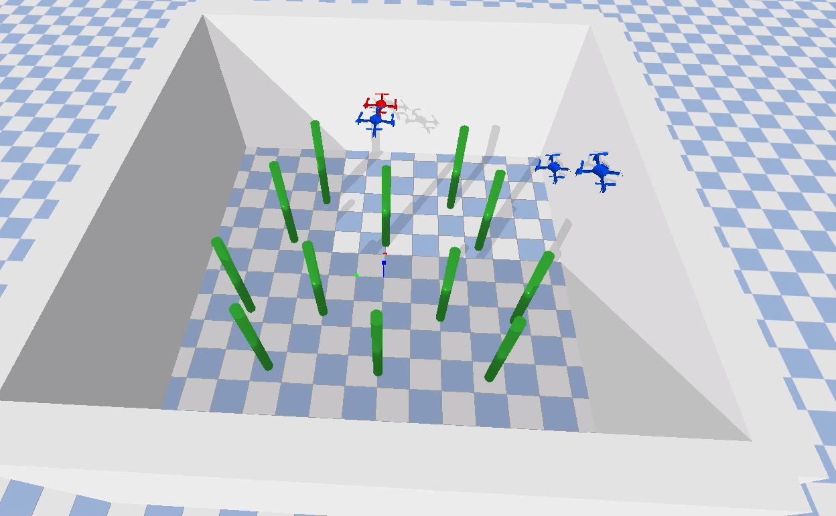
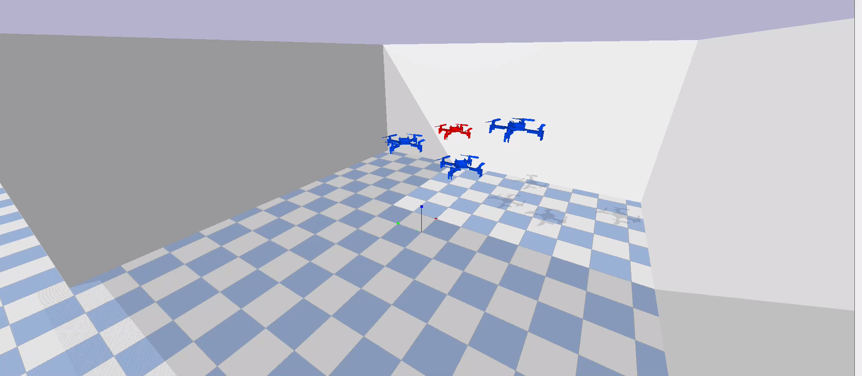
Cont.
Evader Speed: 2.000
Steps: 87/600
Total Reward: 80.4
Min Distance Achieved: 2.47
Capture Radius: 2.50
Drone-Drone Collisions: 0
Drone-Obstacle Collisions: 0

Slide 12
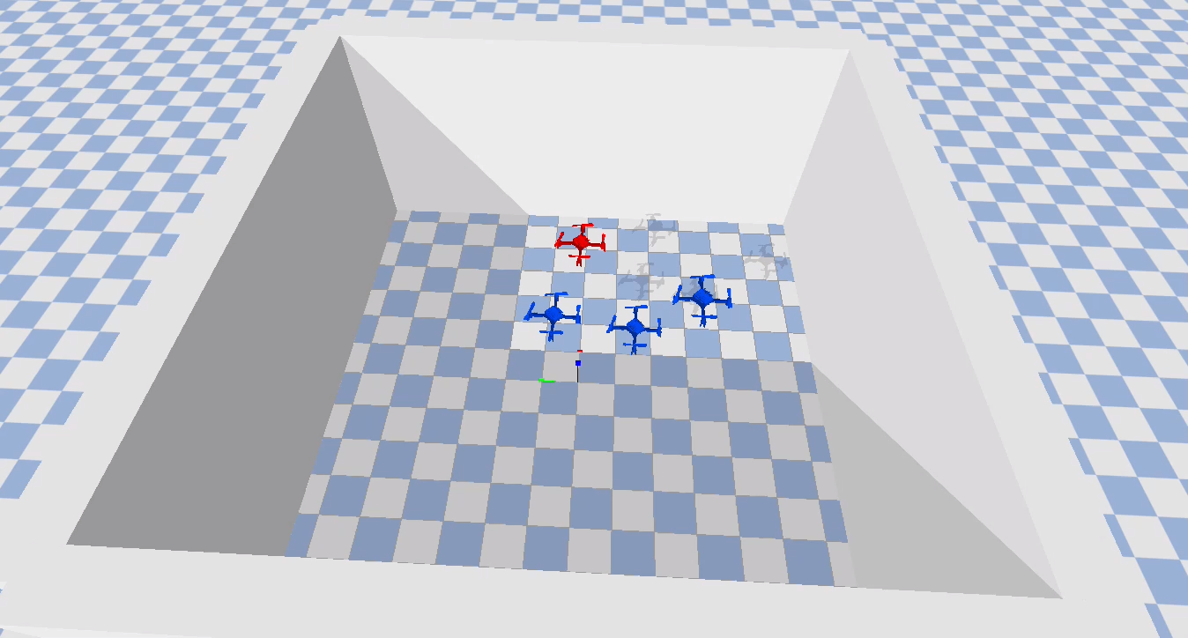
Cont.
custom distance (8) and obstacles (10)
Episodes: 24
Capture Rate: 79.2%
Avg Steps: 160.0
Avg Reward: -4039.1
Avg Min Distance: 2.57

Slide 13


